Slide 1
Different mangoes

Slide 2
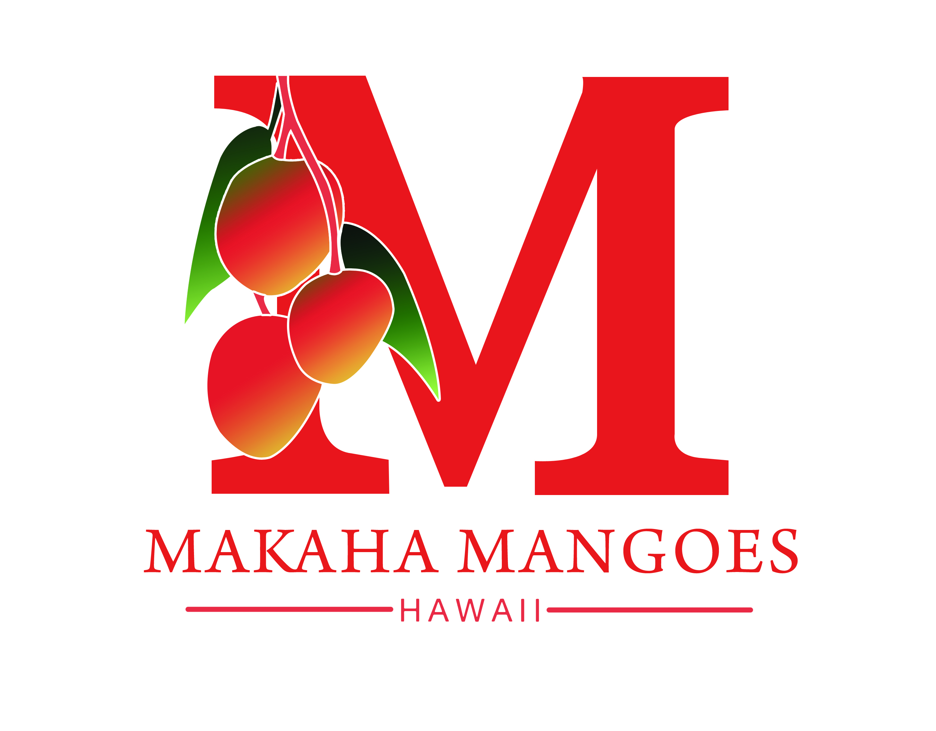
Mark Suiso
MakahaMangoes.com

Slide 3
Hawaii Tropical Fruit Growers www. HTFG.org

Slide 4
No mather your place of birth, culture of color of your skin…there is a mango you hold closest to your heart.

Slide 5
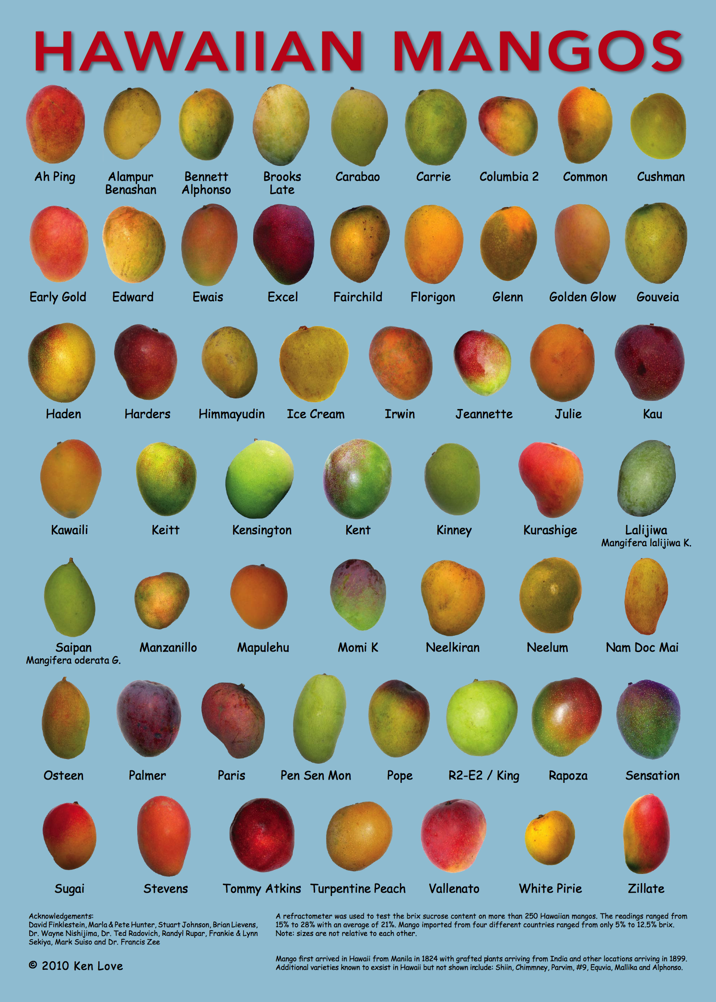

Slide 6
Local Mango

Slide 7
Key Factors
There are three key factors to successful fruit trees
Variety
Environment
Management

Slide 8
Factor 1
Plant Variety-
Origin of variety- Tropics or Sub tropics or Temperate … Hawaii, Florida, Australia, India…
Fruiting season-spring, early summer, late summer...
Dwarf, full size
Taste
Use of tree- shade, home use, comercial, multi use...
Disease resistance
Other fruit character

Slide 9
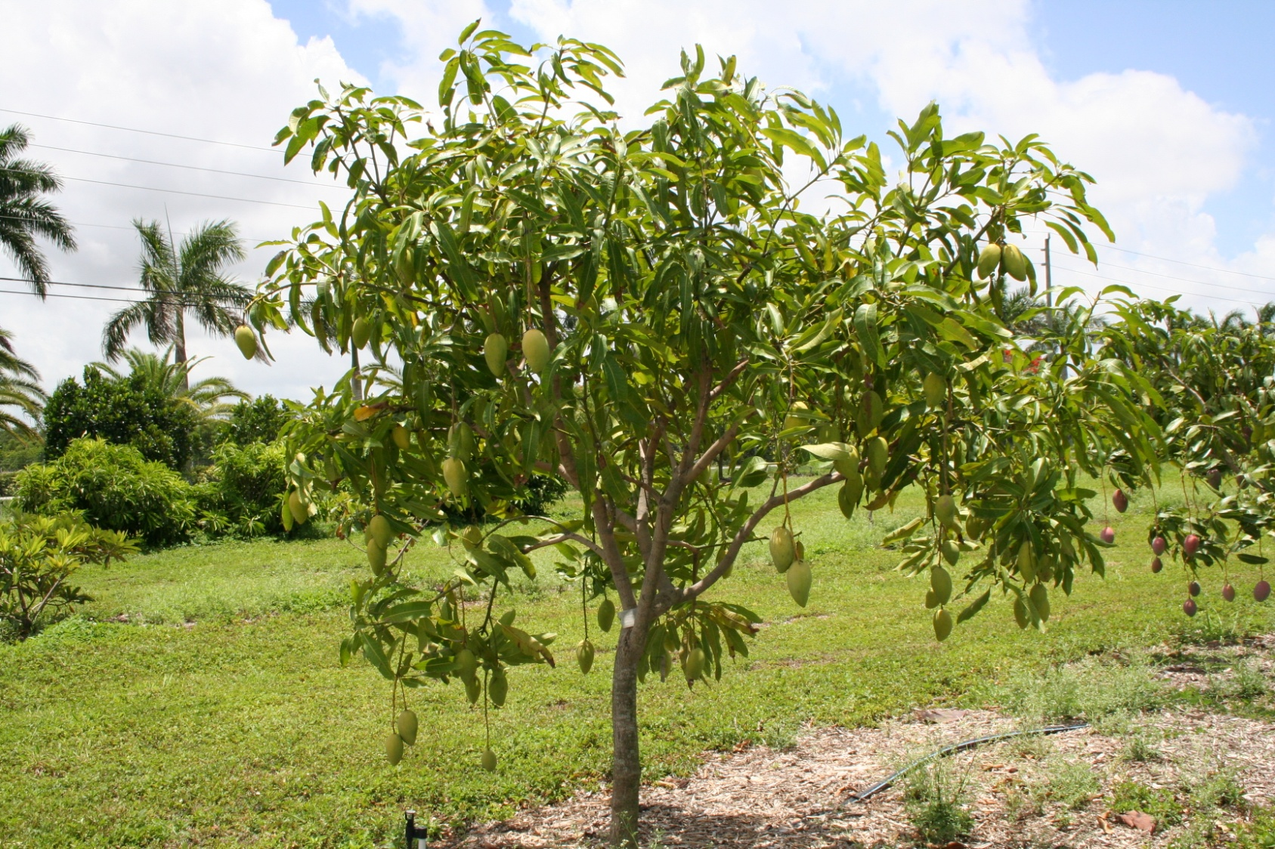
Trend toward smaller trees
Personal preferences
Early season (April-June), blooms at Thanksgiving
Multiple crop, productive, tolerant of disease, easy to grow, semi-dwarf and drought resistance…

Slide 10
Mango chart from web site

Slide 11
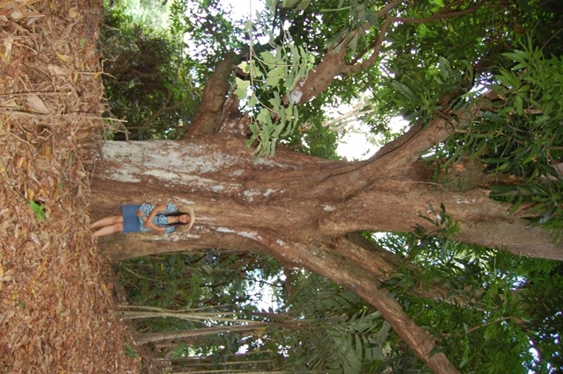

Slide 12
Dwarf cultivars have an advantage: 15 year old ‘Cogshall’

Slide 13
Factor 2
Growing environment/ micro environment
Sun exposure
Elevation/ temperature
Wind exposure
Humidity
Space available
Water
Soil type

Slide 14
Flavor is an issue for mango Depends of the soil type, nutritional status of the tree, other climatic factors
Goa
Notes:
14

Slide 16
Soil web app
http://nrcs.usda.gov/
A project of NRCS- National Resources Conservation Service and Univ. of California Davis.
Free App- look up Soil Web in your App store.
Tap “get soil data” for detail of in current location
Use this along with other climate data to make a short list of probable crop.

Slide 17
Creates Better soil area- use raise bed

Slide 18
Or container

Slide 19
Factor 3
Management- You
Plant density
Prune/ replace
Irrigate
Disease- plant doctor ap --Scot Nelson-
Top work/ … espalier
Harvest timing and method
Post harvest- ripen, cooling…
use of fruit
fertilize
soil/tissue test
Keep learning from experience, research and others

