Slide 1

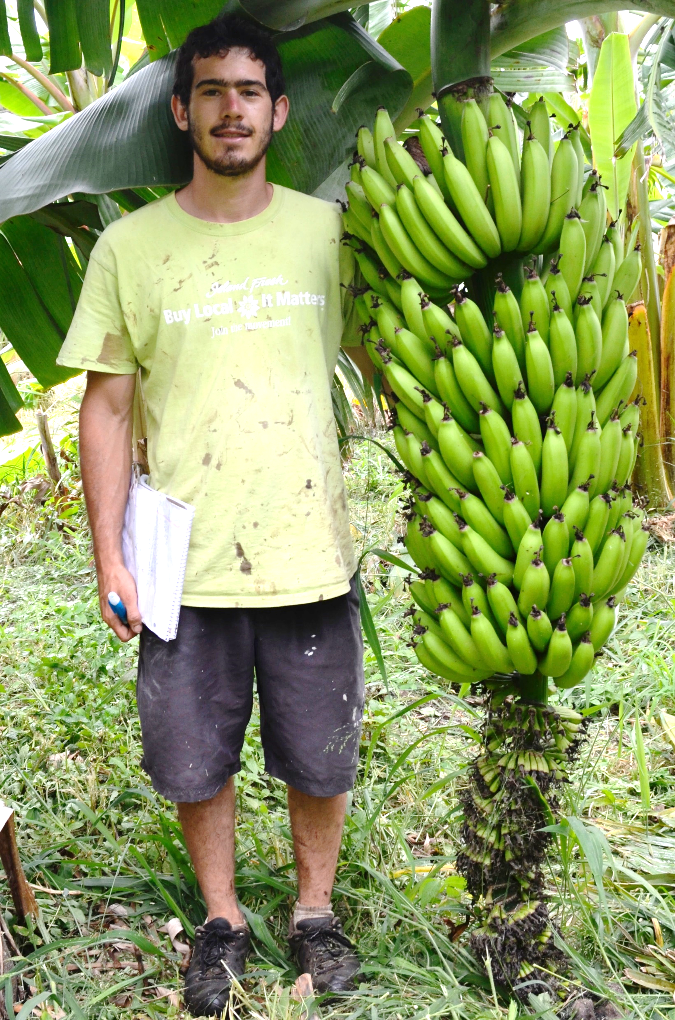
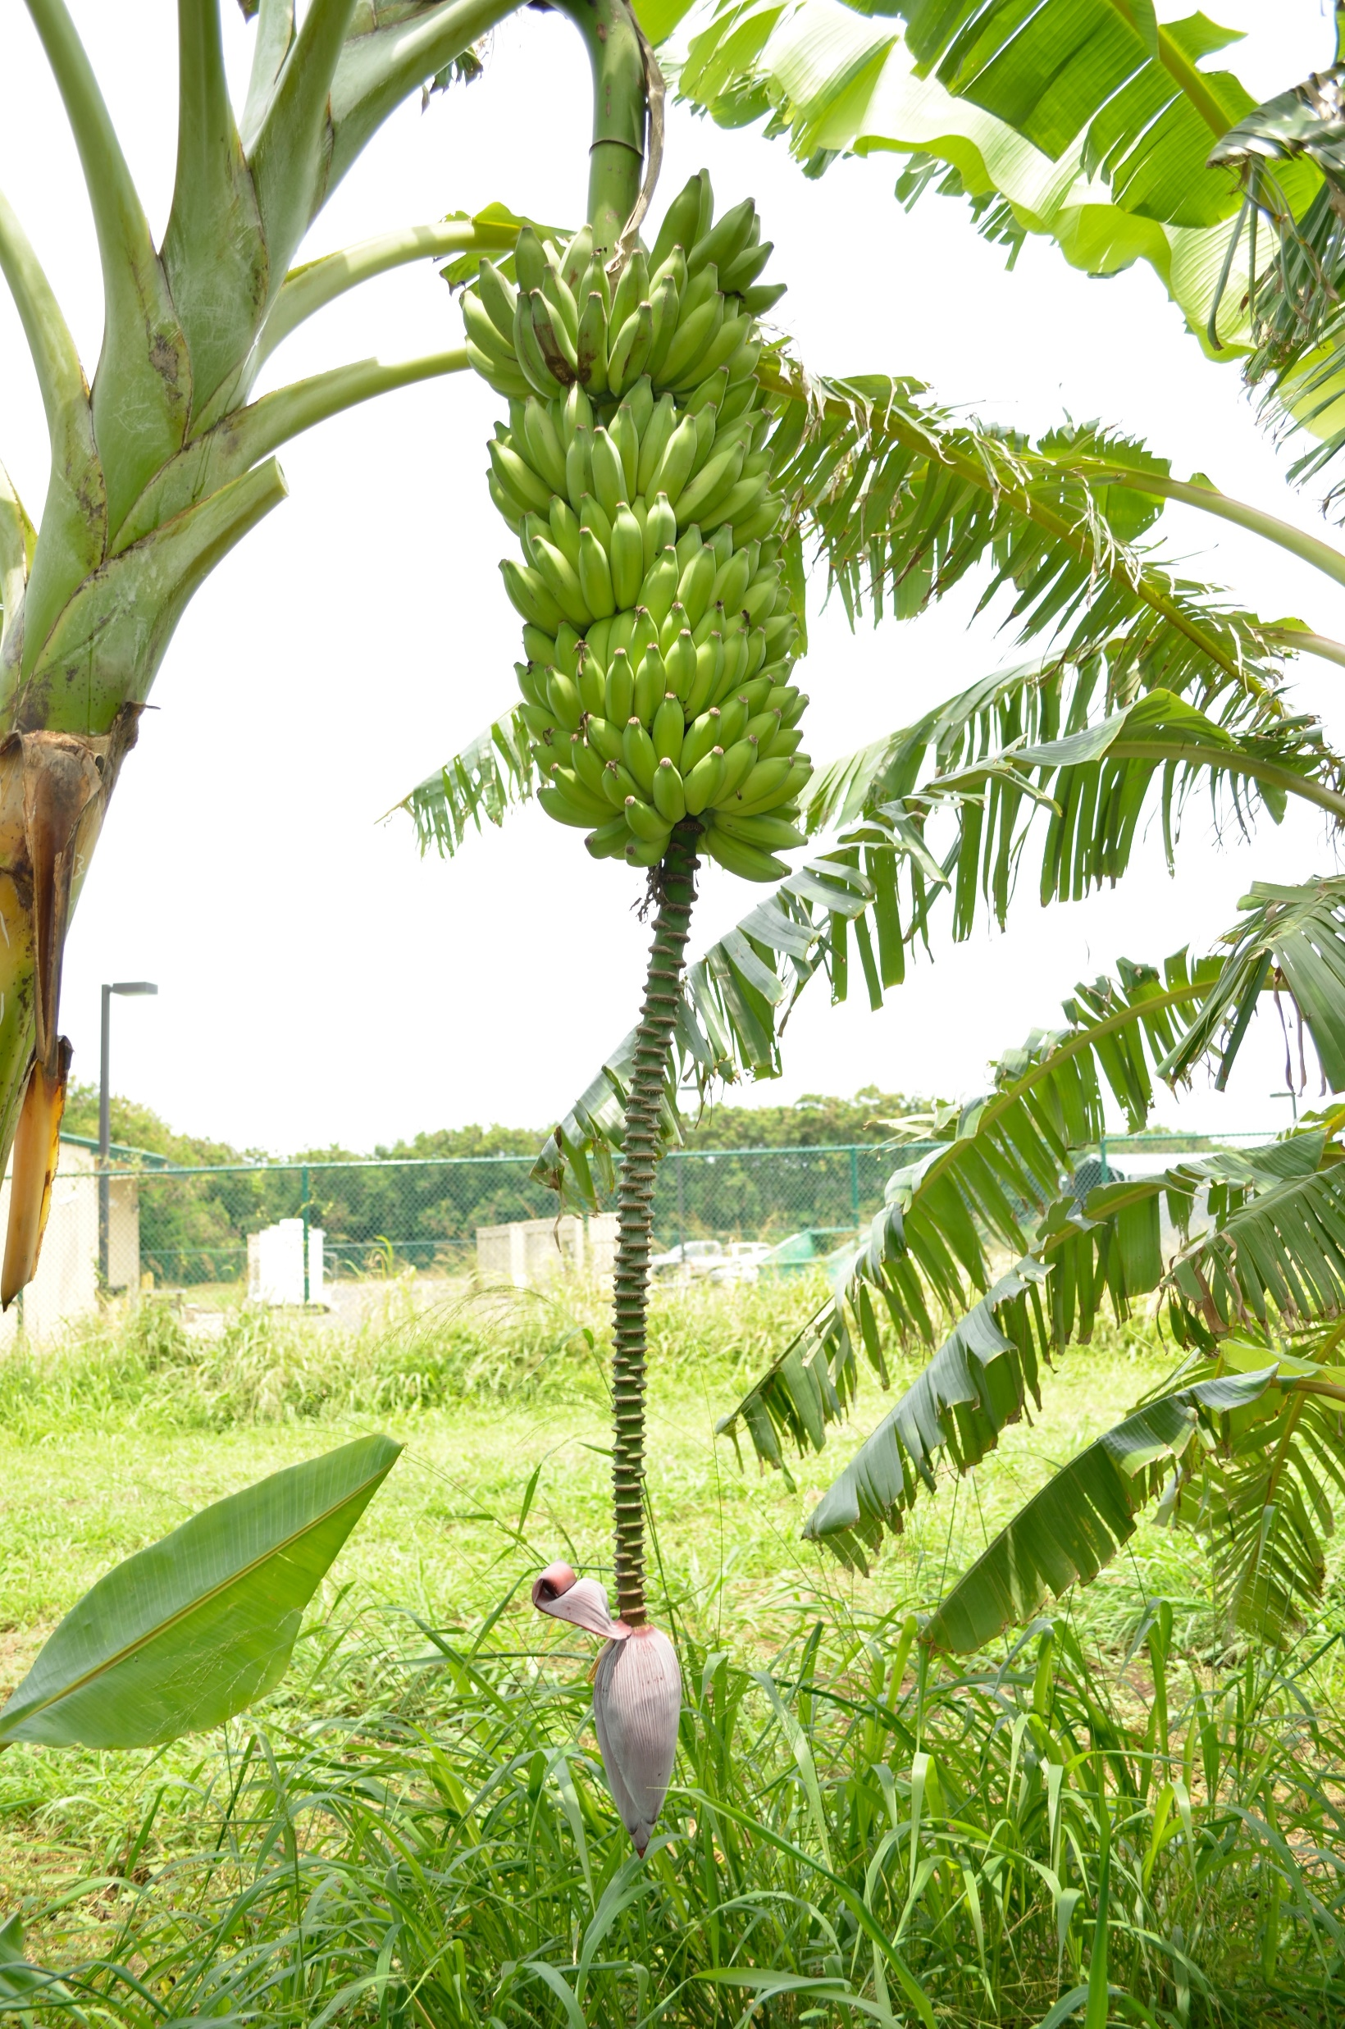
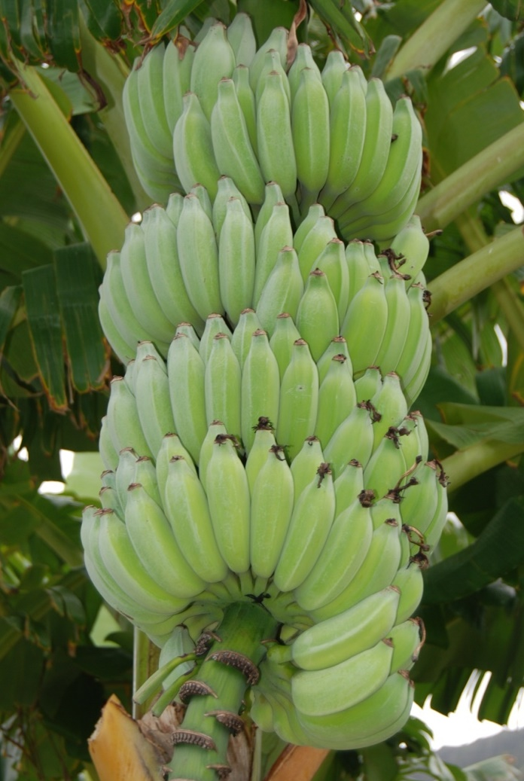
Update on Distribution of BBTV-Resistant Banana Clones
Richard Manshardt manshard@hawaii.edu, CTAHR/TPSS Dept., UH Manoa
Four BBTV-resistant clones identified by Gabe Sachter-Smith (MS 2015).
Clones tissue-cultured and cleaned of BBTV by Asoka Silva in Dr. Mike Melzer’s lab (PEPS 2017-19).
‘Highgate’ (Gros Michel) clone distributed to HTFG cooperators on neighbor islands (March 2020).
Three remaining tissue cultures multiplied by Elisa Mow in Dr. Susan Miyasaka’s TC lab at Komohana Research & Extension Center in Hilo (Spring – Fall 2021).
‘Cocos’ (Gros Michel), ‘Kayinja’ & NPV (Pisang Awak) planned for distribution in winter (2021-22).
Pisang Awak (ABB) clones NPV (left) and ‘Kayinja’ (right)
Gabe with ‘Highgate’ AAA

