Slide 1
EXPANDING Hawaii MARKETS TO THE U.S. MAINLAND USDA APHIS PPQ presented by Dorothy Alontaga

Slide 2
hawaii manual table 3-1 lists approved produce to u.s. mainland from Hawaii See USDA APHIS Website: https://www.aphis.usda.gov/import_export/plants/manuals/ports/downloads/hawaii.pdf

Slide 3
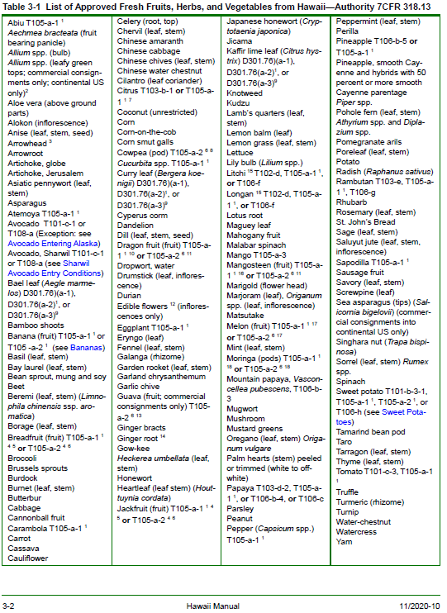
ALWAYS CHECK THE RECENT EDITION IN THE HAWAII MANUAL

Slide 4
How to find the Hawaii manual
Search for USDA APHIS. Choose USDA APHIS | Home Landing Page
Widen screen until Search APHIS appears top right
Type “Manuals” and choose USDA APHIS | Manuals
Commodity Import and Export Manuals lists Hawaii Manual
See Treatment Manual for treatments authorized in the Hawaii Manual.

Slide 5
HAWAII MANUAL: TABLE 3-1 FRUITS, HERBS, & VEGETABLES
Over 145 items listed, but still… it’s only one page.
HI local markets may not meet full potential yet, but…
HI growers may find mainland market advantage certain times of year.

Slide 6
how to add to table 3-1: See Appendix B
On page B-1, the important information to follow is:
“All information should be submitted to … Hawaii Department of Agriculture. After HDOA approval, [HDOA sends to] APHIS PPQ State Plant Health Director’s office [for submittal] to the RCC Unit to begin the review process.”
RCC =Regulatory Coordination and Compliance office USDA APHIS

Slide 7
Appendix B: Must haves-critical information
Contact Information
Produce Name(s), including scientific name
Plant parts
Pest Information: Taxonomy, parts attacked with stages of pest and host, inside, outside, or “with”.
Strategies for Risk Mitigation/Risk Management: If not included, a critical element for HI growers may not be considered. Pest exclusion qualifying under organic label likely important when requests include organic produce.

Slide 8
Produce Name(s) and scientific name
Common name(s) plus Genus and specie
Rarely, Genus spp. considered. But some cultivated species within genus are similar appearance and/or hybridized and pest host records may primarily be at genus level.
Messy taxonomy: Pitahaya/Pitaya/Dragonfruit includes various genera and hybrids Acanthocereus, Cereus, Echinocereus, Hylocerus, /Seneicereus and more.

Slide 9
Plant parts e.g., sepals, leaves, stem length, underground parts, clearly defined
Each plant part adds pest risk but does absence or presence of a part:
…shorten shelf life? …affect customer appeal/causes damage, color change, and spotting? …be more labor intensive?
Discuss with other growers. Include any differences in plant parts if organic and non-organic requested.

Slide 10
PEST INFORMATION
Share information and references with Hawaii Department of Agriculture.
Helpful information if you have it, such as:
- Taxonomic nomenclature for pests along with, parts attacked with stages of pest and host.
- Attacks only certain stage(s) of ripeness? Mature vs. young leaves? Other information?

Slide 11
Strategies FOR Risk Mitigation/Risk Management
Even though plant parts are listed, the risk may be minimized by common practices of removing outside leaves or trimming tops.
Cleaning techniques for root and other crops remove both soil (HI soil is prohibited anyway) and wash off surface pests. Culling produce with holes soft spots, and pest damage may reduce pests.
Suggestion if useful: Is there applicable information in an existing grading scheme that you want to apply & commit to, which reduces pests/damage?

Slide 12
Strategies FOR Risk Mitigation/Risk Management
Page B-2: “11. Overview of agronomic or horticultural management practices used in the production of the commodity, including methods of pest risk mitigation or control programs
12. Identification of parties responsible for pest management and control.”
Often absent. However, requests with systems approaches are benefitted by having this information, e.g. the current Hawaii Sharwil Avocado program.

Slide 13
Strategies FOR Risk Mitigation/Risk Management Bottom of page B-2-4
“While not mandatory” … But may be necessary and/or valuable for risk analysis and subsequent risk management. Include pest mitigations and HI grower common practices if okay to be shared/publicized. E.g: Sanitary practices, greenhouse use for certain plant diseases, organic vs. non-organic practices
Consider, if this is important to HI growers: Note practices growers do not apply because…e.g., adversely affects biological controls.

Slide 14
Things I left out, please see HI manual pages b-2-4
Reality for Appendix B, successful HI commodity requests have not included information such as:
“Commodity Information” re: Area maps
“Shipping Information”: re: Shipping methods, unpredictable. Future growers on other islands, changing realities (i.e. during COVID)? Varietal differences, treatments, delivery mode, refrigeration or none, that shorten or expand shelf life makes it hard to commit to one kind of shipping strategy.

Slide 15
Things I left out, please see HI manual pages b-2-4
Past requests (except Sharwil avocado), have been very short: Name of produce and a pest list, and not much more. With maybe clarification of plant parts, it allows USDA APHIS PPQ commodity analyses to narrow consideration of reasonably cleaned produce to possibly one treatment that comprehensively covers actionable pests.
Callers have asked me what to do; then do not follow through. I hope this presentation is helpful.

Slide 16
The Hawaii manual Table 3-1List of approved Fresh Fruits, Herbs, & vegetables is 1page You can Make it 2 mahalo for your consideration

